Slide 1



MICHAEL ATHERTON ​
VS​
GLENN MCGRATH​ AN ANALYSIS OF ATHERTON'S 19 DISMISSALS AGAINST MCGRATH Group 2
​

Slide 2




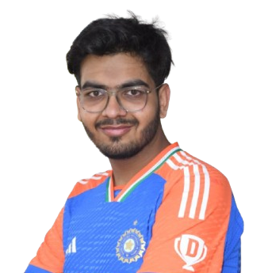

Team Members
2
Yellanki Bhargav sai
Manas Bhansali
Usha Janakiraman
Yellanki Bhargav sai, a third year ComputerScienceEngineering
(Data science) student at Sri Indu Institute of Engineering &Technology Hyderabad
Manas Bhansali, a third year electronics and telecommunication student at Pune Institue of computer technology(PICT),Pune
Usha Janakiraman, a third year Artificial Intelligence and Data Science student at Panimalar Engineering College, Chennai
Shourit Paul
Girish Ravindra Jore
Shourit Paul, a third year Computer Science and Engineering
(spl in data science and a minor in general management)
student at Christ (Deemed to be University), Bengaluru
Girish Ravindra Jore, a third year Information Technology Engineering (Data science)Pune Vidyarthi Griha’s College of Engineering & Shrikrushna S. Dhamankar Institute of Management, Nashik

Slide 3

Introduction
3
The Atherton vs. McGrath Rivalry
A Battle of Skill & Strategy
Cricket has seen many legendary rivalries, but few have been as one-sided as the battle between Michael Atherton and Glenn McGrath.
This presentation analyzes how McGrath dismissed Atherton 19 times, making it one of the most dominant bowler-batsman duels in Test cricket history.​

Slide 4




What this analysis covers
4
Head-to-head stats how often they faced each other
Atherton’s struggles Technical and mental challenges
McGrath’s strategy What made him so successful
Lessons from this rivalry Key takeaways for cricketers

Slide 5
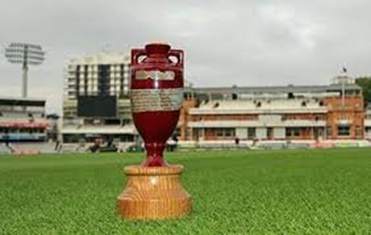
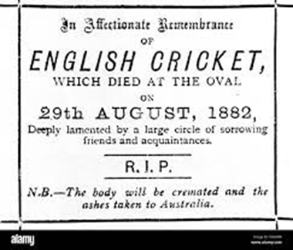
Start of this rivalry
5
ASHES, the oldest rivalry ever in the history of Test Cricket, is a battle contested between England and Australia, for the test supremacy and for winning this coveted trophy.​
This term originated after Australia’s victory over England at The Oval in 1882, its first test win ever on English Soil, and England vowing to bring the ASHES back from Australia.​
This given tagline gave the birth of a new rivalry in the history of cricket named as the ASHES, and it is still the most competitive test rivalries ever.​

Slide 6

PLAYER’S DESCRIPTION
6
Michael Atherton (England) : The Gritty Opener
Full Name: Michael Andrew Atherton​
Role: Right-Handed Opening Batsman​
Team: England (1989-2001), Lancashire​
Playing Style:​ Known for his defensive technique and resilience.​ A patient batsman who could play long innings. Strong against spin but struggled against world- class pacers like McGrath.
​
Career Stats (Tests) :​
Matches: 115​
Runs: 7,728​
Batting Average: 37.69​
Centuries: 16

Slide 7

PLAYER’S DESCRIPTION
7
Glenn McGrath (Australia) : The Master of Line & Length
Full Name: Glenn Donald McGrath
Role: Right-Arm Fast Bowler
Teams: Australia (1993-2007), New South Wales​
Playing Style: One of the most accurate fast bowlers in cricket history. Relied on seam movement and precision rather than extreme pace Consistently targeted the off-stump channel, making life difficult for batsmen.​
Career Stats (Tests)​
Matches: 124​
Wickets: 563​
Bowling Average: 21.64​
Best Figures: 8/24​

Slide 8



Bouncer Ball Challenge, Mistakes & Improvement
8
Atherton responds to a rising delivery
Instead of ducking, he jumps to play the ball
Increased exposure to head/body impact
Jumping Instead of Ducking
Lack of Balance
Increased Impact Risk
Maintain Balance
Stay Low
Track the Ball Carefully
Use Proper Technique
OBSERVATIONS
SCOPE OF IMPROVEMENT
MISTAKES IDENTIFIED

Slide 9
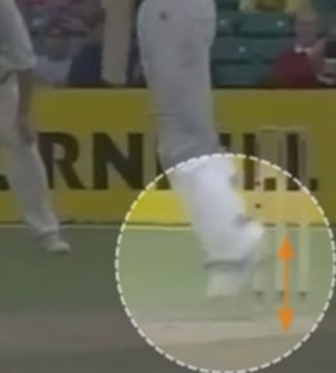
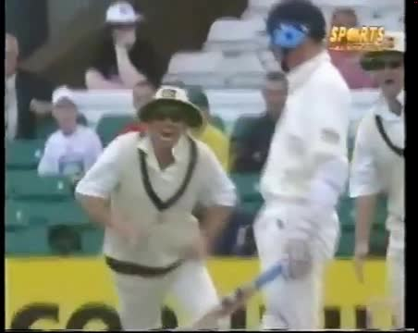
Video analysis
9
Click here to play video
Credits: robelinda 2 (Youtube)

Slide 10
Frequent Edges
10
Open Bat Face
Playing Away from the Body
Hard Hands
Footwork Issues
McGrath’s Accuracy
Better Shot Selection
Improved Footwork
Soft Hands
Bat Closer to the Body
Tactical Adjustments
OBSERVATIONS
SCOPE OF IMPROVEMENT

Slide 11
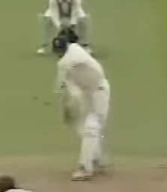
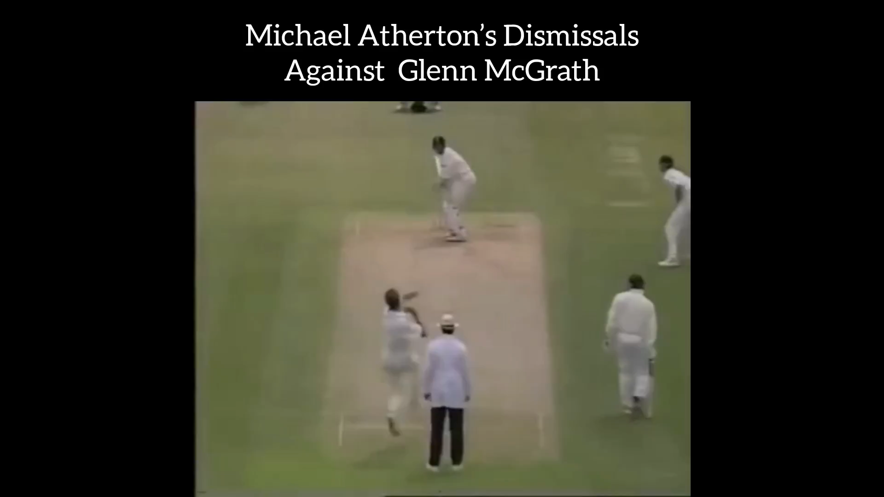
Video analysis
11
Click here to play video
EDGE OF THE BAT
Credits: robelinda 2 (Youtube)

Slide 12
The Short Ball Challenge​
12
Head Position
Reluctant Hooker
Dragging towards leg side
Lack of Power
Used subtle variations
Staying balanced for better control
Developing a confident hook shot
Committing early to attack or leave
Short-Arm Jabs Tactical Adjustment
Adapting to bounce and pace changes
OBSERVATIONS
SCOPE OF IMPROVEMENT

Slide 13
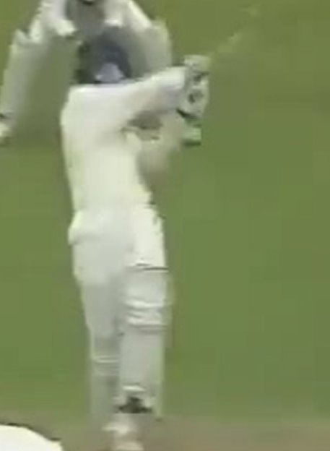
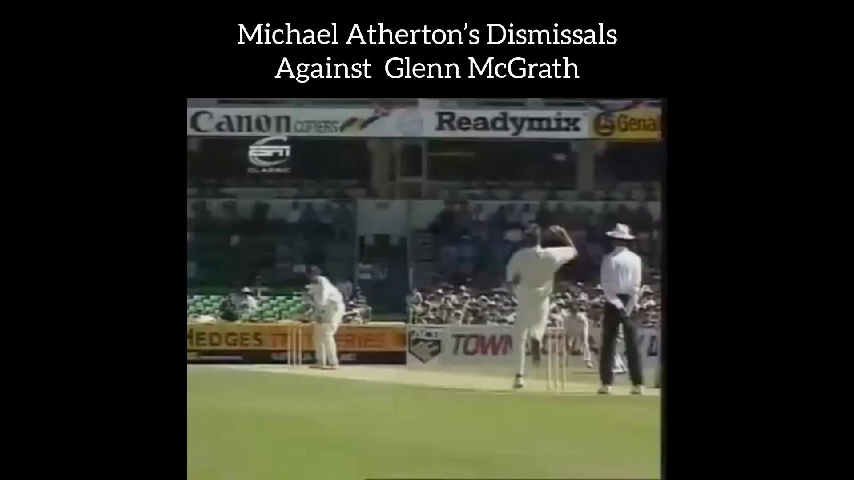
Video analysis
13
Click here to play video
Credits: robelinda 2 (Youtube)

Slide 14
POOR DECISION MAKING
14
Better Footwork
Improved Shot Selection
Adaptation to McGrath’s Line and Length​
Tactical Changes
Poor Foot Movement (Stuck on the crease)​
Indecision (Front or Back Foot?)​
Playing at Balls He Should Have Left​
Firm Grip, Leading to Edges​
Repeated Mistakes (Failure to Adapt)​
OBSERVATIONS
SCOPE OF IMPROVEMENT

Slide 15
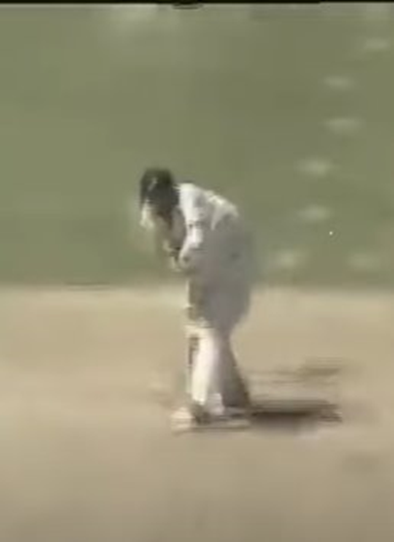
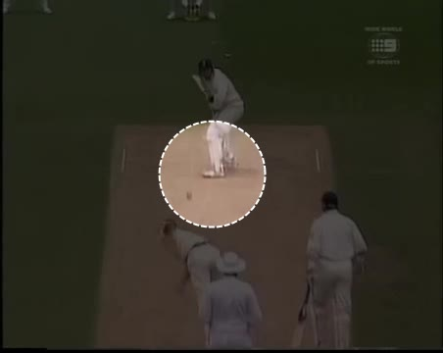
Video analysis
15
Click here to play video
Poor Foot Work
Credits: robelinda 2 (Youtube)

Slide 16
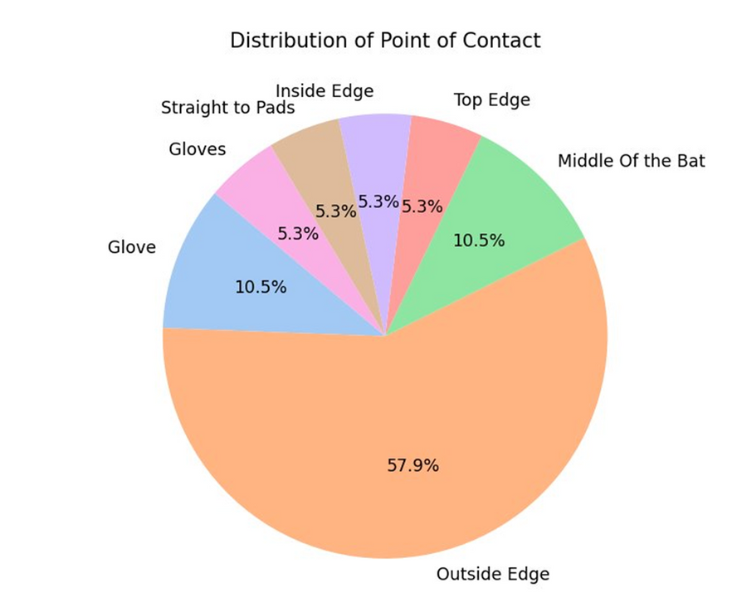
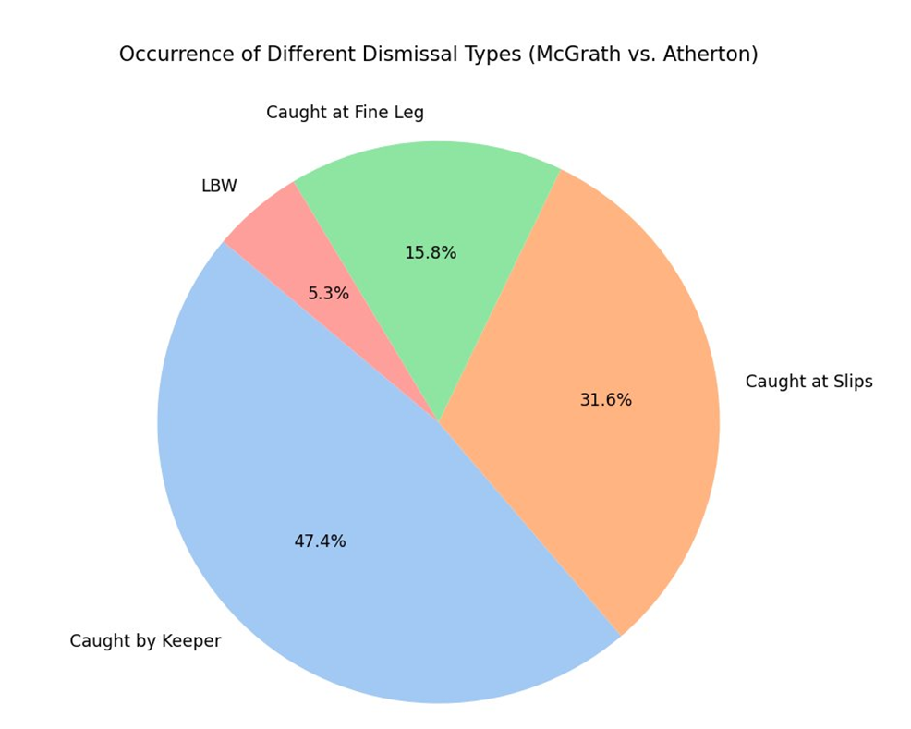

VISUALISATIONS
16
More Visualizations

Slide 17
CONCLUSION​
17
Summary
Atherton’s Strength: Technically sound batsman.
McGrath’s Weapon: Relentless accuracy and off-stump line.
Seam Movement & Pressure: Key factors in dismissals.
One-Sided Rivalry: 19 dismissals, a dominant battle.
Lessons Learnt
For Batsmen: Footwork, shot selection, and patience are crucial.
For Bowlers: Accuracy, consistency, and mental tactics outweigh raw pace.
For Fans: A prime example of cricket’s mental and technical battles.
Final Thought
“Atherton vs. McGrath was not just a battle of skills but also a battle of mind games. While Atherton showed resilience, McGrath proved why precision and pressure can dominate even the best batsmen”.

Slide 18
BALL BY BALL ANALYSIS
18
For the detailed analysis of our project, please click on the below excel sheet
Excel Sheet

Slide 19
INDEPTH ANALYSIS FOR ALL 19 BALLS
19
For the detailed video analysis of our project, please click on the below 19 Balls Video analyis
19 Balls Video analysis

Slide 20
20
QUESTIONS?

Slide 21
21
THANK YOU

